Slide 1

Pricing Homes in Melbourne, Australia
Lincoln Brown and James Mulvihill

Slide 2
Agenda
Expanding into Australia
The Data
Modeling
Results and Recommendations

Slide 3

Australia
Exchange Rate is about 1.3 AUD to 1 USD in 2017
Land tax instead of Property tax which means no Assessed Property Values

Slide 4

Melbourne
Voted most livable city in the world for seven years in a row in 2017 and continues to be close to the top today
Quickly growing city

Slide 5
The Data
Our data was sourced from a Housing Data Snapshot on Kaggle.
The data was originally scraped from domain.com.au

Slide 6
Dataset Features
The original dataset contained over 13,000 records of properties sold with 21 columns.
We narrowed this down to only keep single-family homes and townhouses.
We used Price as our target variable.
Key Columns
Price | Location (Longitude, Latitude)
Landsize | # of Rooms/Bed/Bath
Distance | Seller
Region Name | Suburb
Postcode | Property Type

Slide 7
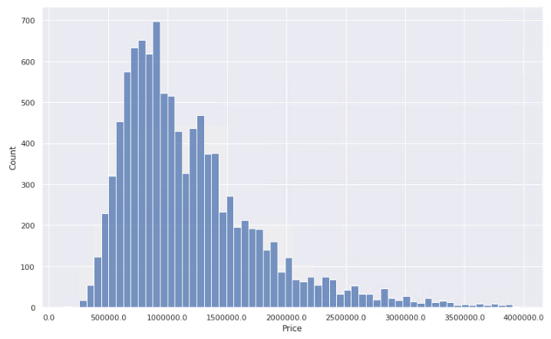
House Price Distribution

Slide 8
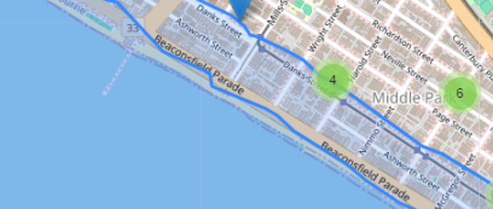
Waterfront Properties
With Melbourne being a coastal city, it was important to identify which properties are on or close to the coast.
We added a Boolean column to the dataset that indicates if the property is within 200 meters of the coast.

Slide 9
Data Preprocessing
We took several steps to ensure the data was ready to be loaded into our models.
These included:
Removing missing values
Encoding categorical variables
Feature selection and engineering

Slide 10
Model Evaluation
We tested three models during our process, including Linear Regression, Decision Tree, and Random Forest.
We evaluated the models on Root Mean Squared Error (RMSE), Mean Absolute Error (MAE), and R2 score.
Model | RMSE | MAE | R2
Linear Regression | 301,296 | 225,158 | 0.55
Decision Tree | 302,648 | 211,754 | 0.54
Random Forest | 202,831 | 144,277 | 0.79

Slide 11
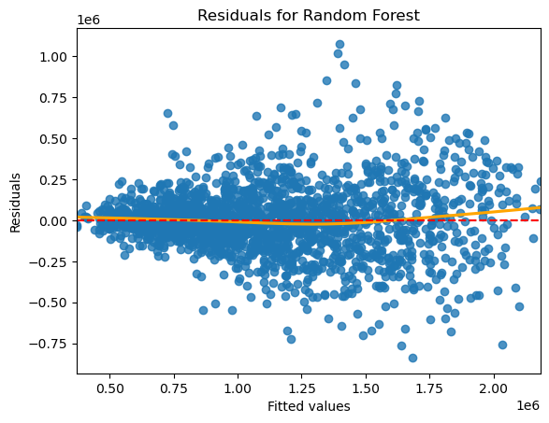
Model Selection
Ultimately, we selected the Random Forest model because it performed the best based on the evaluation metrics we used.
In addition, we further evaluated the performance of the model using a Residual Plot.

Slide 12
Model Insights
Our model selected these features as the most influential on Price:
Distance from City Center
Latitude
Longitude
Landsize – How big the property is
Postcode

Slide 13
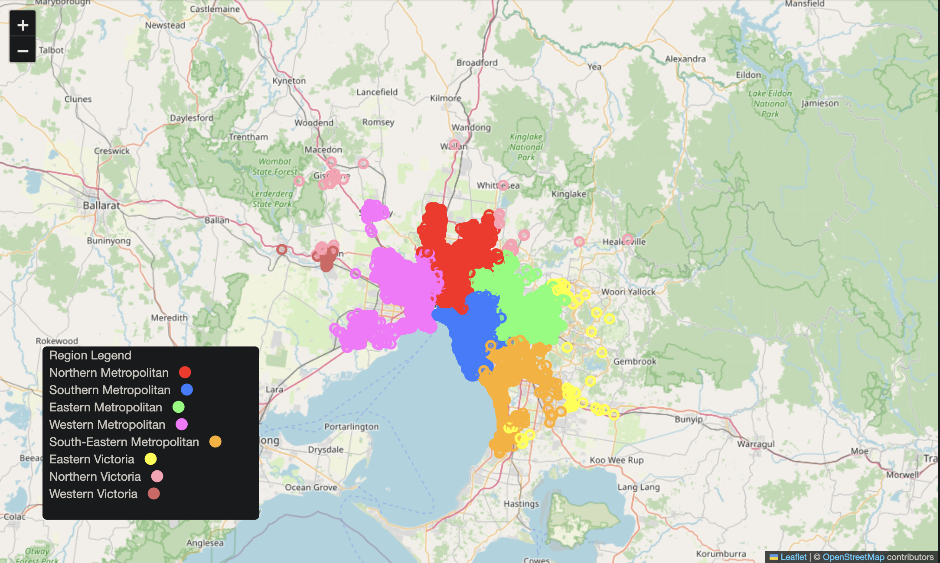
Melbourne Region Map

Slide 14
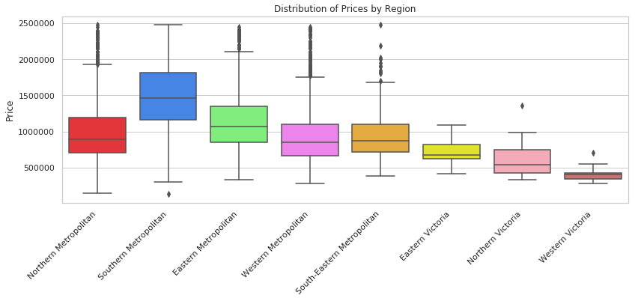
House Sale Prices by Region

Slide 15
Thank you
Lincoln Brown and James Mulvihill
Insight Realty Solutions
www.InsightRealtySolutions.com
LincolnB@InsightRealtySolutions.com
JamesM@InsightRealtySolutions.com

